Slide 1


Slide 2

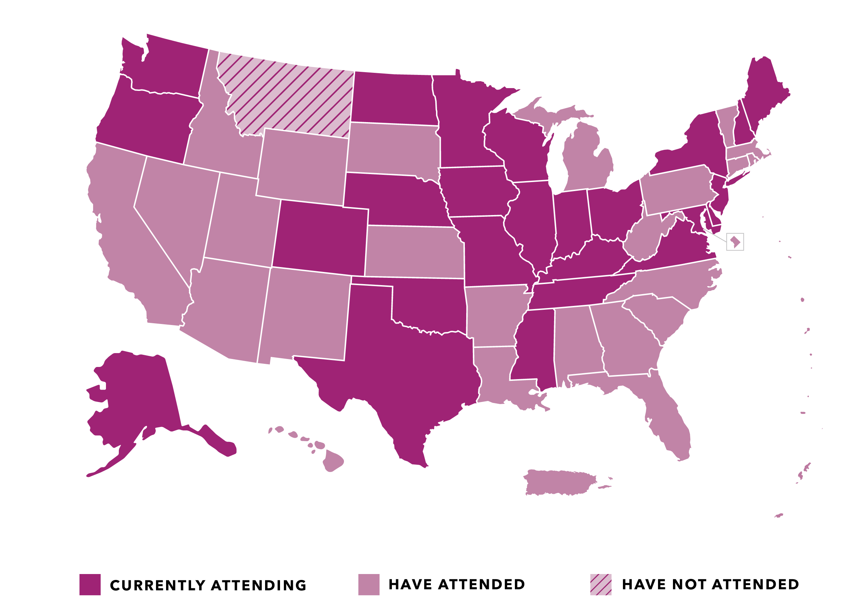
States Represented at Medicaid Policy Academies

Slide 3
Facilitating Leaders
Representative Ed Clere
Indiana
Representative Susan Lontine
Colorado

Slide 4


Slide 5


Impact of COVID-19 on Medicaid
Robin Rudowitz, Co-Director
Kaiser Program on Medicaid and the Uninsured
The Henry J. Kaiser Family Foundation
CSG Meeting
September 23, 2020

Slide 6







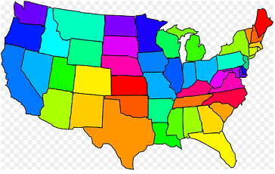
Medicaid plays a central role in our health care system.
Health Insurance Coverage For 1 in 5 Americans
Assistance to 10 million Medicare Beneficiaries
> 50% Long-Term Care Financing
MEDICAID
Support for Health Care System and Safety-Net
State Capacity to Address Health Challenges

Slide 7

The basic foundations of Medicaid are related to the entitlement and the federal-state partnership.
Federal State
Entitlement
Eligible Individuals are entitled to a defined set of benefits
States are entitled to federal matching funds
Sets core requirements on eligibility and benefits
Flexibility to administer the program within federal guidelines
Partnership

Slide 8
Over two-thirds of all Medicaid beneficiaries receive their care in comprehensive MCOs.
WA
VT
ME
MT
ND
MN
NH
OR
MA
SD
WI
NY
ID
MI
RI
WY
PA
CT
NE
IA
NJ
IL
IN
OH
DE
NV
CO
MD
CA
UT
WV
VA
DC
KS
MO
KY
NC
AZ
TN
SC
NM
OK
AR
MS
AL
GA
AK
TX
LA
FL
Share of Medicaid beneficiaries in MCOs
>75% (24 States)
HI
50-75% (12 States including D.C.)
1 < 50% (3 States)
U.S. Overall = 69%
No MCOs (12 States)
SOURCE: Medicaid Managed Care Enrollment Reports, Centers for Medicare and Medicaid Services, U.S. Department of Health and Human Services, 2019.
Notes:
Nationwide, over two-thirds of all Medicaid beneficiaries were enrolled in MCOs, as of July 2017.

Slide 9
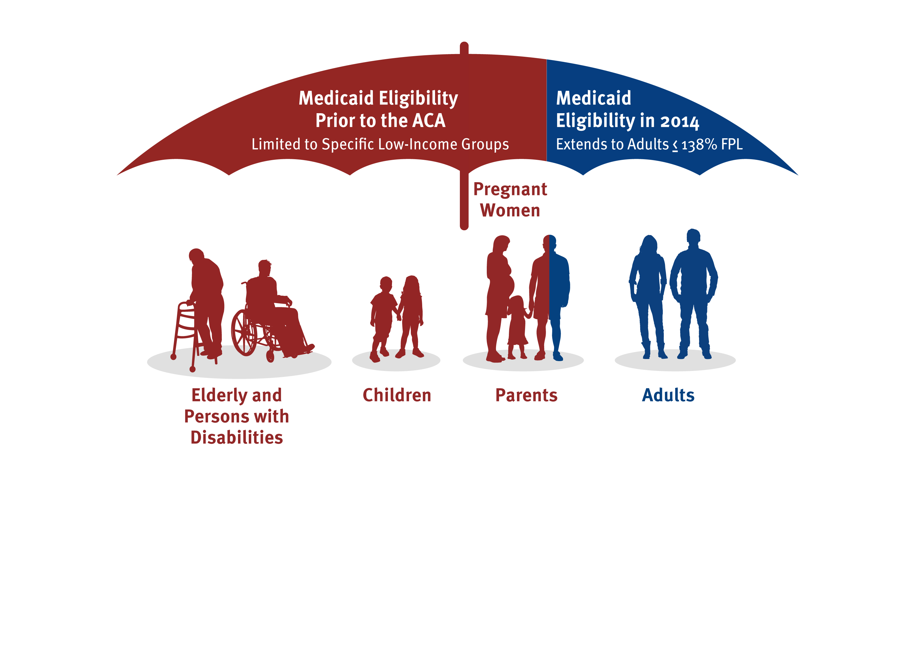
The Medicaid expansion was designed to fill the gaps in Medicaid coverage.
NOTE: The June 2012 Supreme Court decision in National Federation of Independent Business v. Sebelius maintained the Medicaid expansion, but limited the Secretary's authority to enforce it, effectively making the expansion optional for states. 138% FPL = $16,743 for an individual and $28,676 for a family of three in 2018.

Slide 10
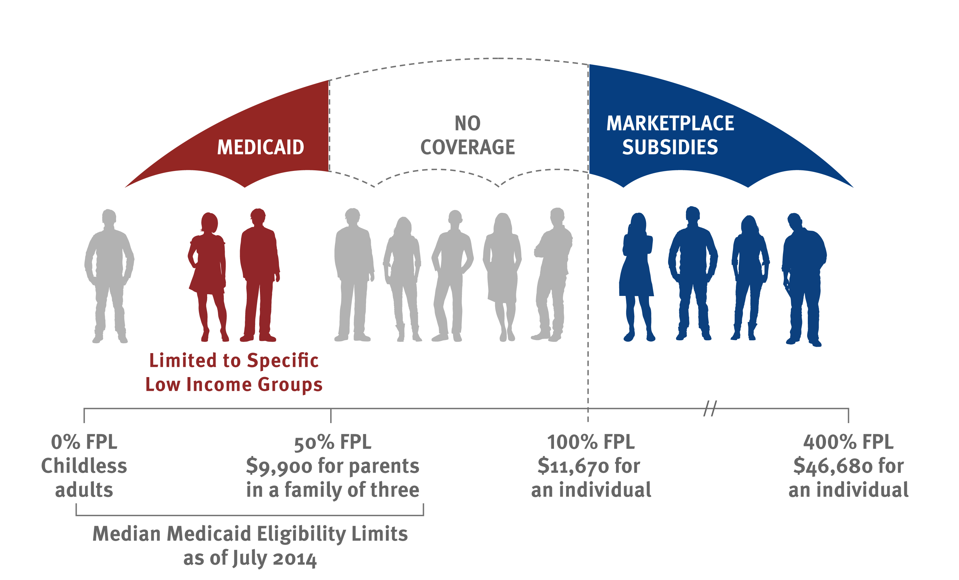
Gaps in coverage for adults remain in states that have not implemented the ACA Medicaid expansion.
41% FPL
$8,745 for parents
in a family of three
$12,140
for an individual
$48,560
for an individual
as of October 2014
as of January 2019
Notes:
Liz 5/29/18

Slide 11
Status of State Medicaid Expansion Decisions
ME
WA
VT
MT
ND
MN
NH
OR
MA
WI
NY
ID
SD
MI
RI
WY
CT
IA
PA
NJ
NE ◊
OH
DE
NV
IL
IN
MD
UT
CO
WV
VA
CA
KS
MO ◊
KY
DC
NC
TN
AZ
OK ◊
AR
SC
NM
MS
AL
GA
Adopted (39 States including DC)
TX
LA
AK
Not Adopting At This Time (12 States)
FL
HI
NOTES: Current status for each state is based on KFF tracking and analysis of state activity. ◊Expansion is adopted but not yet implemented in MO, NE, and OK. (See link below for additional state-specific notes).
SOURCE: “Status of State Action on the Medicaid Expansion Decision,” KFF State Health Facts, updated August 5, 2020. https://www.kff.org/health-reform/state-indicator/state-activity-around-expanding-medicaid-under-the-affordable-care-act/

Slide 12


Evidence from over 400 studies suggests that the Medicaid expansion has positive effects for beneficiaries and states.
Reduction in the Number
of Uninsured
Increased Access to Care and Service Utilization
↑ Affordability and Financial Security
+
Increased State Savings
↓ Uncompensated care costs
↓ State-funded health programs (e.g. behavioral health and corrections)
Federal + State Funds
Increased Economic Activity
↑ General fund revenue and GDP
↑ or neutral effects on employment
SOURCE: M. Guth, R. Garfield, and R. Rudowitz, The Effects of Medicaid Expansion under the ACA: Updated Findings from a Literature Review (Washington, DC: Kaiser Family Foundation, March 17, 2020), https://www.kff.org/medicaid/report/the-effects-of-medicaid-expansion-under-the-aca-updated-findings-from-a-literature-review/
Notes:
Updated 3/2018 (LA)
Alternate title: The Medicaid expansion has coverage and fiscal implications for states.

Slide 13
Medicaid spending is mostly for the elderly and people with disabilities.
NOTE: Totals may not sum to 100% due to rounding.
SOURCE: KFF estimates based on analysis of data from the FFY2014 Medicaid Statistical Information System (MSIS) and CMS-64 reports. Because FFY2014 data was missing some or all quarters for some states, we adjusted the data using secondary data to represent a full fiscal year of enrollment.

Slide 14
Medicaid is a budget item and a revenue item in state budgets.
SOURCE: Kaiser Family Foundation estimates based on the National Association of State Budget Officers (NASBO) 2019 State Expenditure Report: Fiscal Years 2017-2019 (data for Actual FY 2018).

Slide 15
Medicaid spending and enrollment increases during economic downturns.
NOTE: Spending growth percentages refer to state fiscal year (FY).
SOURCE: FY 2019-2020 spending data and FY 2020 enrollment data are derived from the KFF survey of Medicaid officials in 50 states and DC conducted by Health Management Associates, October 2019; historic data from various sources including: Medicaid Enrollment June 2013 Data Snapshot, KCMU, January 2014. FY 2014-2018 are based on KFF analysis of CMS, Medicaid & CHIP Monthly Applications, Eligibility Determinations, and Enrollment Reports and from KFF Analysis of CMS Form 64 Data.

Slide 16
Implications of COVID-19 for Medicaid & State Budgets
Enrollment: Expected increase in total spending and enrollment due to job and income loss.
  More people will be eligible for coverage in expansion states but likely more uninsured particularly in non-expansion states
  Unlike other health coverage, there are no open enrollment periods
Spending: State costs for Medicaid are expected to go up as Medicaid enrollment goes up; at the same time revenues are expected to decline.
  Medicaid FMAP serves as automatic adjuster – as costs go up, so do federal matching funds
  As more people enroll in the ACA Medicaid expansion, the federal match will continue to be 90% for those costs
Federal Legislation: Families First Coronavirus Response Act included a temporary increase in the regular Medicaid match rate of 6.2 percentage points (does not apply to expansion group)
  Enrollment protections included in the law (MOE)
  An increase in the FMAP has proven to be an efficient and effective way to get money to states

Slide 17
Medicaid enrollment and spending growth rate projections for FY 2020 and FY 2021 amid COVID-19
Based on number of states with projections available
34
31
32
30
Enrollment
Spending
NOTES: Spending and Enrollment: FY 2020–States were asked about current projections relative to pre-pandemic projections. FY 2021–States were asked about FY 2021 growth projections relative to FY 2020. We do not show data for states with no projections available.
SOURCE: KFF survey of Medicaid officials in 50 states and DC conducted by Health Management Associates, April – May 2020.

Slide 18
After declines in enrollment before the pandemic, this trend began reversing in March.
NOTE: May 2020 data are preliminary and subject to change.
SOURCE: CMS, Medicaid & CHIP: Monthly Application and Eligibility Reports, last updated August 20, 2020.

Slide 19
16.8 million could become eligible for Medicaid due to loss of employer sponsored coverage by January 2021.
Total = 26.8 M
Notes: Medicaid eligible includes people eligible for other public coverage, such as CHIP. Totals may not sum due to rounding.
Source: KFF. Job Losses occurred March 1st through May 2nd, 2020. See Methods for more details.

Slide 20
States do not have easy options to constrain Medicaid spending.
Enrollment - States cannot cut eligibility and must provide continuous coverage to current enrollees due to the MOE requirements.
Spending
  Some costs are going up (rate adjustments, retainer payments and telehealth)
  Utilization changes may not result in reduced spending for MCO states
  Typical strategies like benefit cuts / rate reductions / provider taxes may not be feasible
Match Rate – Due to the match rate (especially for expansion group), states need to make large program cuts to realize state savings

Slide 21
The amount of fiscal relief from the FFCRA increase in the FMAP depends on when the public health emergency ends.
NOTE: Estimates based on the 6.2 percentage point increase in the Families First Coronavirus Response Act (FFCRA). Dates Assume when the FMAP increase ends, so assumes the public health emergency ends in the prior quarter. Estimates include only the effects on Medicaid and do not include the effects of the increase on CHIP.
SOURCE: KFF analysis.

Slide 22
States are making a number of policy changes in response to COVID-19 through emergency authorities.
States are taking action to address COVID-19 but emergency authorities are temporary and actions require state resources. Actions include:
Enrollment changes beyond the MOE requirements
  Eliminating / waiving premiums in Medicaid and CHIP
  Streamlining application processes
  Adopting the new option to cover COVID-19 testing for the uninsured (19 states)
Long-term services and supports
  Streamlining HCBS enrollment and expanding financial / functional eligibility
  Adding benefits, increasing utilization limits, relaxing prior authorization
Prescription drugs
  Waiving / extending prior authorization
  Allowing for early refills
  Increasing maximum supply or quantity limits of certain medications
SOURCE: KFF analysis of approved SPAs and the Medicaid Disaster Relief SPA Template, approved HCBS waiver Appendix Ks and the Appendix K Template; approved COVID-19 Public Health Emergency Section 1115 demonstrations; approved Section 1135 waivers; and Medicaid actions to address COVID-19 posted on publicly available state websites.

Slide 23


In response to COVID-19, states are expanding telehealth in Medicaid by making adjustments to key areas:
Populations
Services & Payment Rates
Allowing new services to be delivered via telehealth
Adjusting payment rates and cost sharing
Expanding the Medicaid populations that can use telehealth
Technology
Providers
Expanding the technologies used to deliver telehealth
Allowing more types of distant and originating sites
Broadening provider types that may deliver services via telehealth
SOURCE: Centers for Medicare and Medicaid Services (CMS), State Medicaid & CHIP Telehealth Toolkit, April 2020, as well as KFF analysis of Medicaid telehealth guidance posted to state websites.

Slide 24
MCO Payment Issues: State Options and Factors to Consider in Responding to COVID-19
Options to Address MCO Payment Issues | Options to Direct MCO Provider Payments | Goals / Factors to Consider when Evaluating Options
Two-sided risk corridors Capitation rate adjustments Kick payments Covering costs on a non-risk basis Carve-outs | State directed payments: Enhanced minimum fee schedules Uniform dollar or % increase per service Retainer payments for certain HCBS providers | Mitigating MCO & state risk MCO & provider cash flow issues Beneficiary access & continuity of care Administrative burden (MCO, state, & federal)
SOURCE: KFF, Medicaid Managed Care Rates and Flexibilities: State Options to Respond to COVID-19 Pandemic. https://www.kff.org/medicaid/issue-brief/medicaid-managed-care-rates-and-flexibilities-state-options-to-respond-to-covid-19-pandemic/

Slide 25
Key Questions Looking Ahead
How will the pandemic and economic downturn affect Medicaid spending and enrollment in SFY 2021?
  What actions can states take to address Medicaid / overall budget shortfalls?
  What policies can states adopt to support providers and ensure access to coverage?
What will happen with temporary increase in the FMAP?
  When will the PHE period end?
  How will states transition from emergency authorities
  Will Congress increase / better target that relief?
How will the November elections impact Medicaid?

