Slide 2
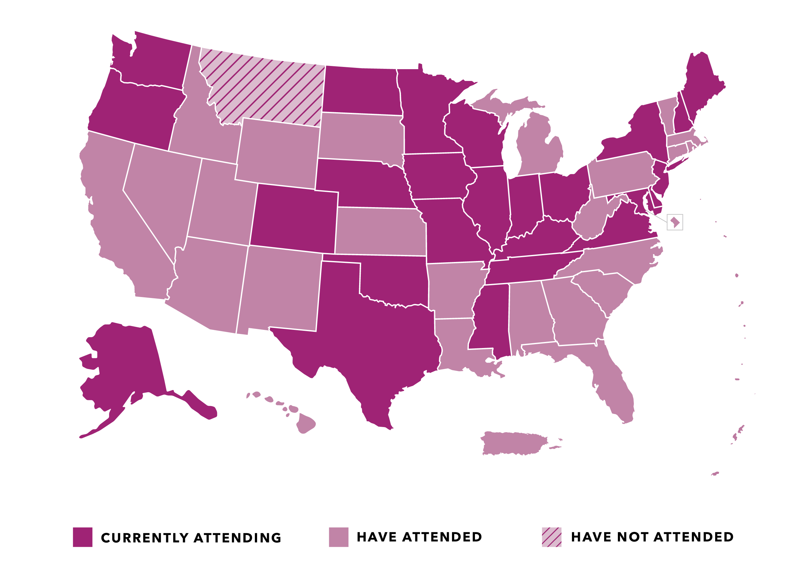
States Represented at Medicaid Policy Academies

Slide 3
Facilitating Leaders
Representative Ed Clere
Indiana
Representative Susan Lontine
Colorado

Slide 6
COVID-19: Immediate Impact on Kansas Medicaid
Secretary Lee A. Norman, MD, MHS, MBA
Kansas Department of Health and Environment | State Health Officer
CSG Virtual Policy Academy – Medicaid Leadership
23 September, 2020

Slide 7
Objectives: to discuss and understand
COVID-19 impacts on Kansas
The context in which this occurred
The Kansas pandemic response, including Medicaid impacts and adjustments

Slide 8
COVID-19: Immediate Impact on Kansas Medicaid
“Humanity has but three great enemies: fever, famine, and war; of these by far the greatest, by far the most terrible, is fever.”
- Sir William Osler, MD (1849-1919)
7

Slide 9
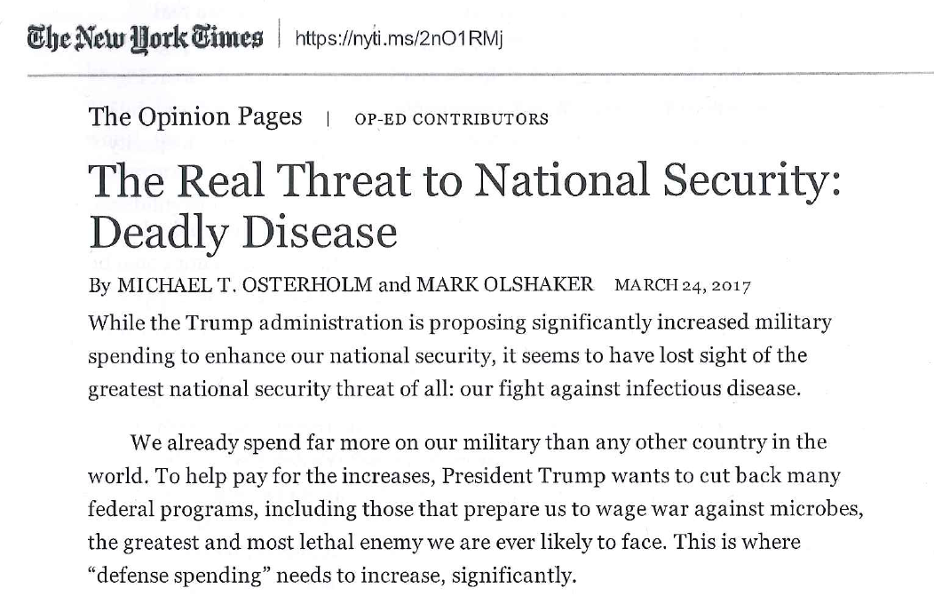
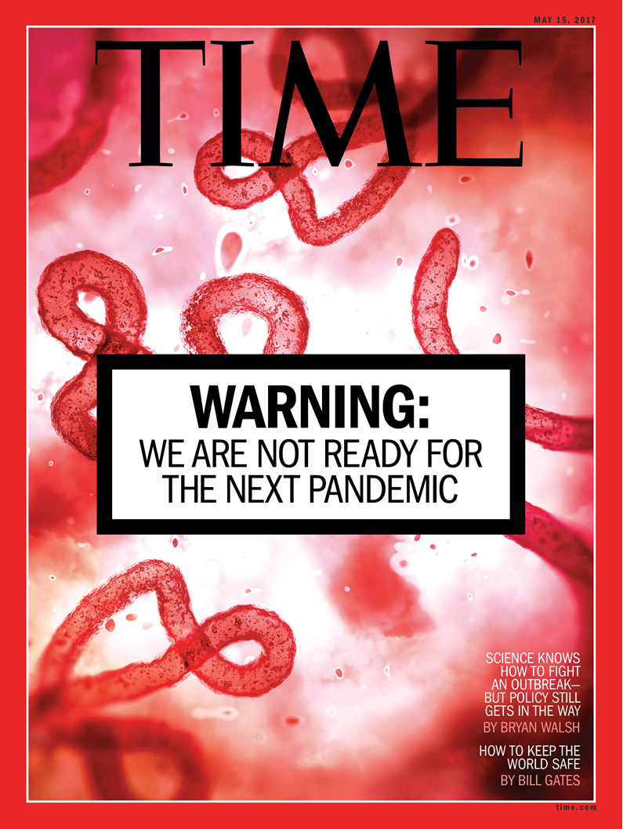
COVID-19: Immediate Impact on Kansas Medicaid
Protect and Improve the Health and Environment of all Kansans

Slide 10
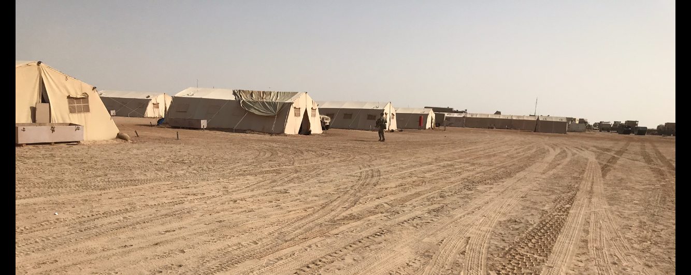
Recent experiences have helped inform our approach
H1N1
MERS-CoV

Slide 11
The context: US and Kansas

Slide 12
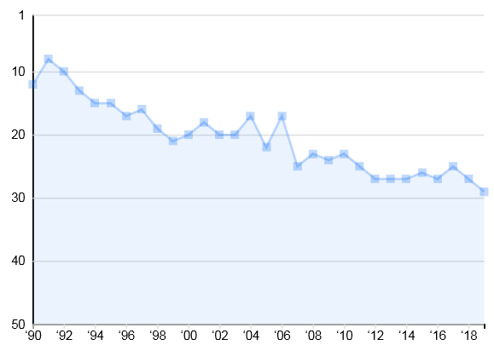
Of all the states in the US, over the past 30 years, Kansas has seen the greatest decline in its health rankings.
Kansas Health Ranking
1990-2019
“
Rank
(America’s Health Rankings, December 6, 2019)
Edition Year

Slide 13
Significant concern about Kansas public health capacity
Under-investment in public health
Antiquated State public health and lab
Emergency preparedness position at “phase Ø” (stability operations) with little surge capability
Strained Local Health Department (LHD) and safety net resources
And then COVID-19 arrives…

Slide 14
Immediate response?
Federal (CDC, FEMA, White House)
State and Local
Denial, anger, defensiveness
Competing messaging
Politicizing everything Covid-related
Shortages and competition: PPE, testing platforms and supplies
Long test result turnaround times
Immediate incident command
County and State emergency declarations
Unification with State Emergency Operations Center (SEOC) / KDEM
Capacity-building despite constrained resources
Early strategic decision-making

Slide 15
Kansas Medicaid - background
Managed Medicaid program
95% in managed care
Three MCOs
No Medicaid expansion in KS
Political party differences: Governor and both houses
Economic downturn in some sectors before Covid-19 arrived

Slide 16
Kansas response Lines of Effort (LOE)

Slide 17
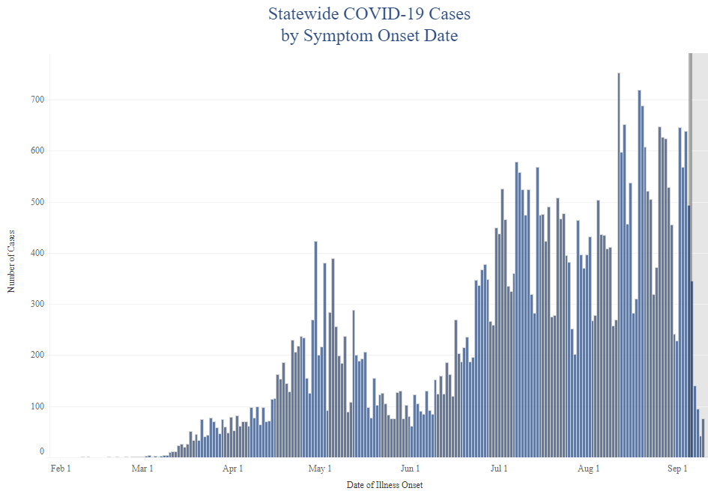
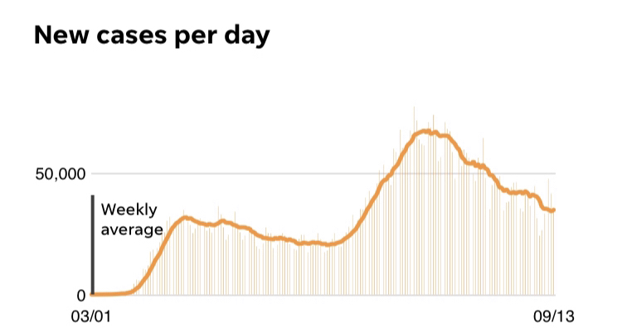
New cases, Kansas and the US

Slide 18
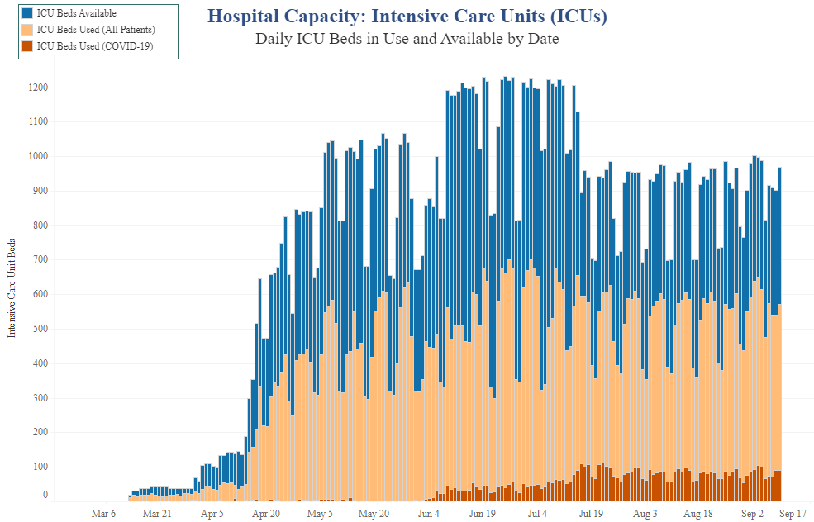

Slide 19
Public policy matters
Ad Astra Plan becomes guidance, not a mandate

Slide 20
Moving safely ahead – the minimum
COVID-19: Reopening
Can do RT-PCR testing for every person that needs a test today
Hospitals have enough surge capacity to handle a rapid 25% increase in patients requiring ICU care
Healthcare workers have adequate PPE supplies to handle the surge in care
Syndromic surveillance in place

Slide 21
Medicaid during COVID-19 period:
Families First Coronavirus Response Act (18 MAR 2020)
Targeted federal interventions for Medicaid and CHIP programs for duration of federal emergency
Enhanced FMAP as long as
Eligibility standards/premiums not more restrictive than those on 1 JAN 2020
Eligibility cannot be terminated for current beneficiaries eligibility on/after 18 MAR 2020
Suspends eligibility redeterminations from 18 MAR 2020 on through last day of declared emergency

Slide 22
Medicaid program impacts, to date:
Applications and new enrollments dropped (suspension of eligibility redetermination)
Increased overall enrollment (due to same)
Agency current in processing new applications
CHIP / MCHIP extended for 19-year olds
Fewer face-to-face visits, especially in HCBS
Technology-assisted/telehealth
Opened new codes now eligible
Allowed home as originating site
MCO responses
PPE, lunches, tablets for telehealth
Day-to-day operational impacts
Workplace priorities redirected to support new guidelines
Lack of infrastructure to work remotely

Slide 23
What does the future hold?
Understanding “genetic drift” and change in the virus
Status of vaccine development

Slide 24
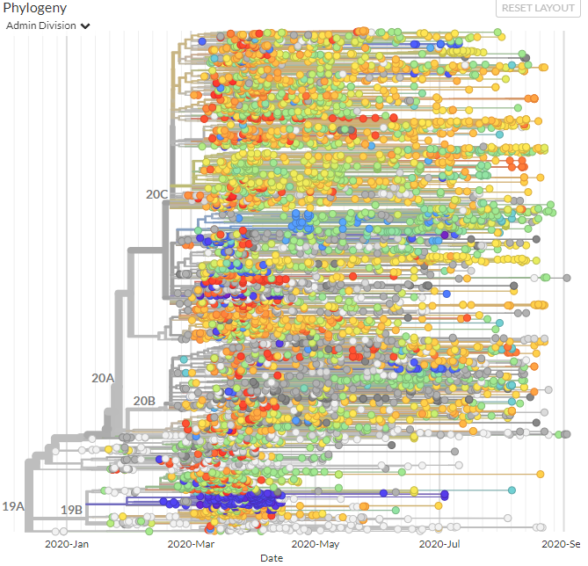
https://www.gisaid.org/epiflu-applications/hcov-19-genomic-epidemiology/

Slide 25
SARS-CoV-2 vaccine prospects

Slide 26
Questions and discussion
“Nobody ever thanks you for saving
them from the disease they didn’t
know they were going to get.”
- William Foege
Protect and Improve the Health and Environment of all Kansans

