Slide 2
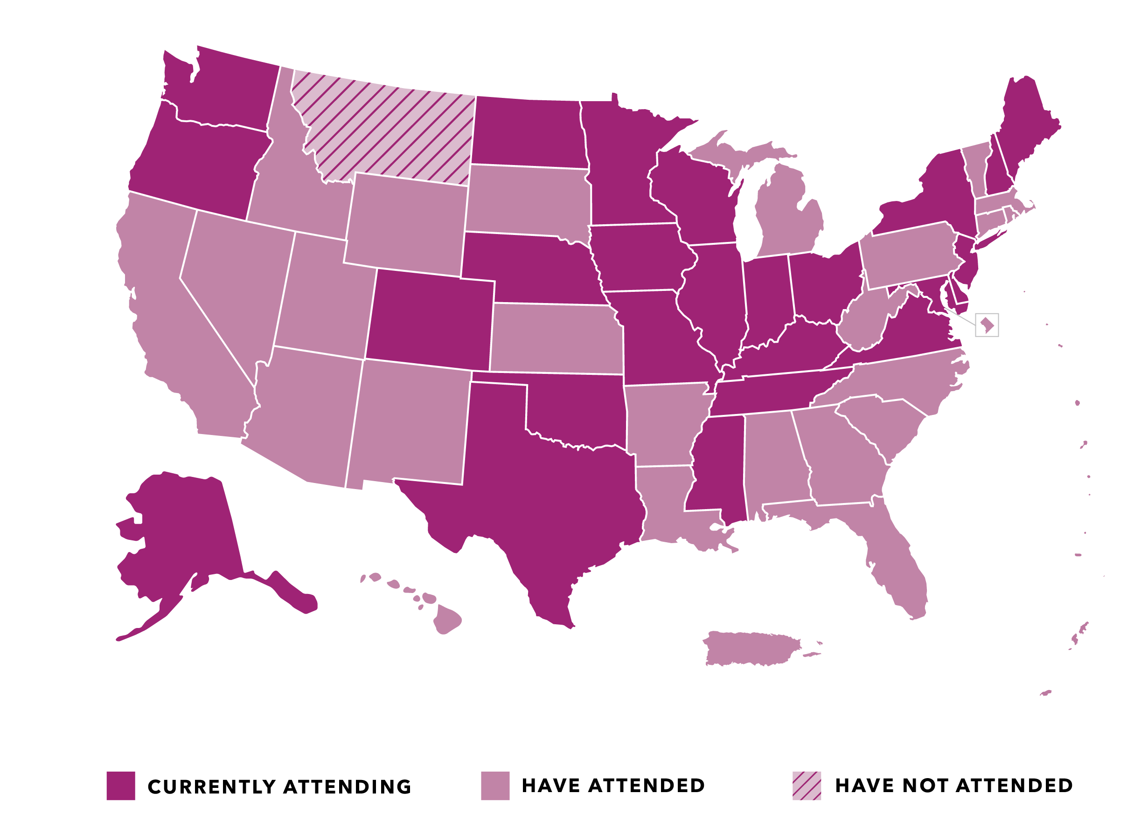
States Represented at Medicaid Policy Academies

Slide 3
Facilitating Leaders
Representative Ed Clere
Indiana
Representative Susan Lontine
Colorado

Slide 6
Louisiana Department of Health & COVID-19 Response
Dr. Courtney Phillips, Secretary
Louisiana Department of Health
September 23, 2020

Slide 7
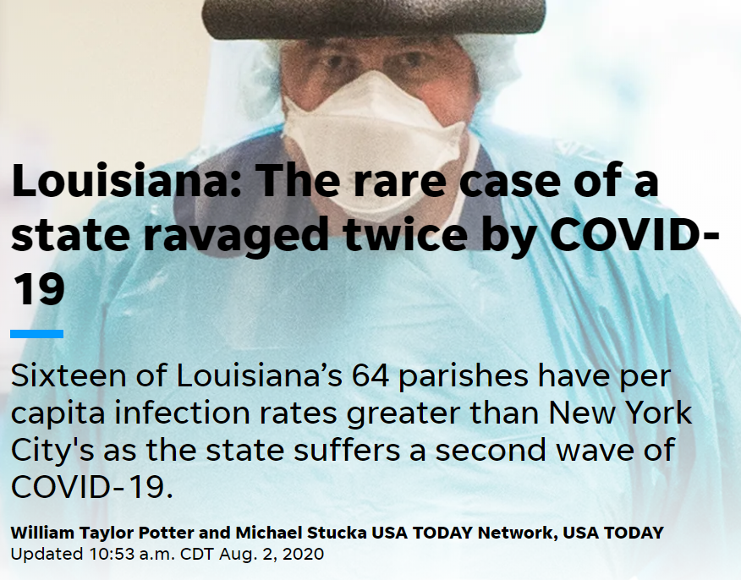
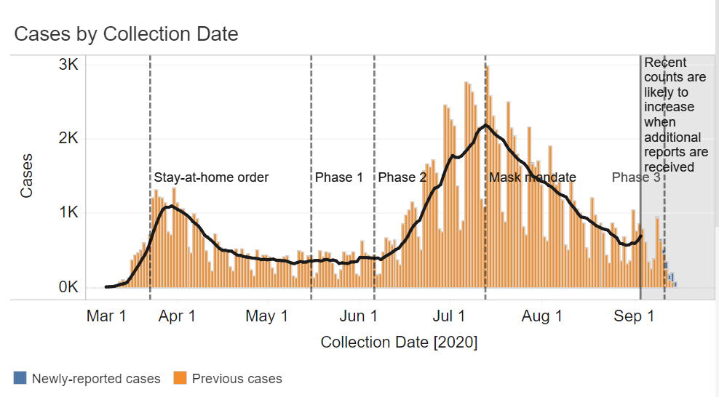
COVID in Louisiana
Notes:
As many of you will remember, Louisiana, and New Orleans in particular, was one of the early hotspots for COVID-19 in late March and April. Later, in July, our cases and hospitalizations would again peak at an alarmingly high level, with the second wave being more dispersed across the entire state.
While the first peak in the chart may look small relative to the second, it’s important to remember that in March and April, like most other states, we did not have widespread community-based testing yet in place, so the majority of the cases that you see represented in that first peak, were cases that were admitted to and tested in a hospital setting. We were not capturing many of the asymptomatic cases or those with minor symptoms at that time. Governor John Bel Edwards acted swiftly, putting a stay at home order in place just two weeks after our first case was confirmed.
Like many states, the stay at home order and business restrictions were gradually lifted throughout late May and June. The increased activity, particularly among young people led to a second peak occurred in mid-July and also placed tremendous strain on our hospital’s resources and resulted in a significant increase in deaths in our state. Closing bars statewide, reducing the allowable size of gatherings, and mandating face coverings statewide helped to bring down the number of new cases and hospitalizations but not to the same level that the stay at home order did.

Slide 8
Louisiana's COVID Response
Decisions driven by data & science
Real time data & information sharing with public and press
Strategic communications & messaging
Medicaid policy changes
Widespread community-based testing
Focus on health equity
Notes:
Our department has led our state’s multi-pronged approach to COVID response. The core components and principles of our response effort have been in place since the earliest days of the pandemic and although our response has not been without its missteps and challenges, these components have served us very well.
I’m going to discuss each in more detail throughout the rest of my presentation, but the six areas that I’d like to highlight are: decision-making driven by data and science, real time information sharing with the public and the press, strategic communications and messaging, Medicaid policy changes, widespread community-based testing, and a focus on health equity in our response.

Slide 9
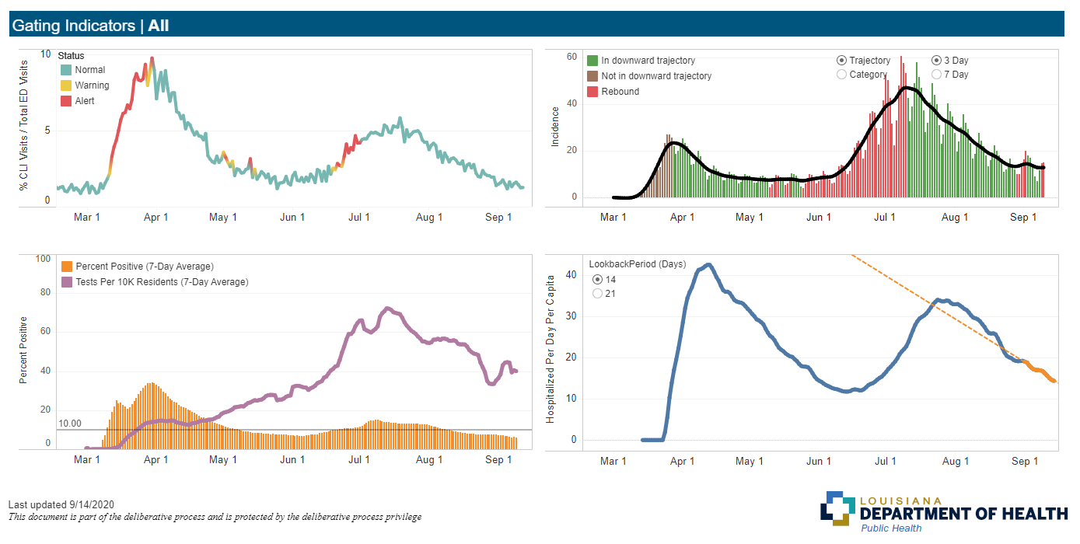
Data & science for decision making
1. ED Visits for COVID-Like Illnesses
2. Epidemic Curve (daily incidence of cases per 100k residents)
3. Tests per 10,000 residents & percent positivity
4. Hospitalizations per 100k residents over a 14-day period
Notes:
Built an internal “gating criteria” dashboard to determine if/when state was ready to move to the next phase of re-opening, using CDC metrics and thresholds.
Consulted at least twice weekly with internal and external experts including epidemiologists, physicians, statisticians, and hospital leadership to analyze and interpret data and to ensure that our data accurately reflected their experience in their communities and facilities.
The Governor and our Assistant Secretary of Public Health always displayed and discussed this information publicly during the press conferences when announcing decisions about whether the state was moving to a new phase of re-opening, or if we were putting in place new restrictions like closing down bars or imposing a statewide mask mandate.

Slide 10
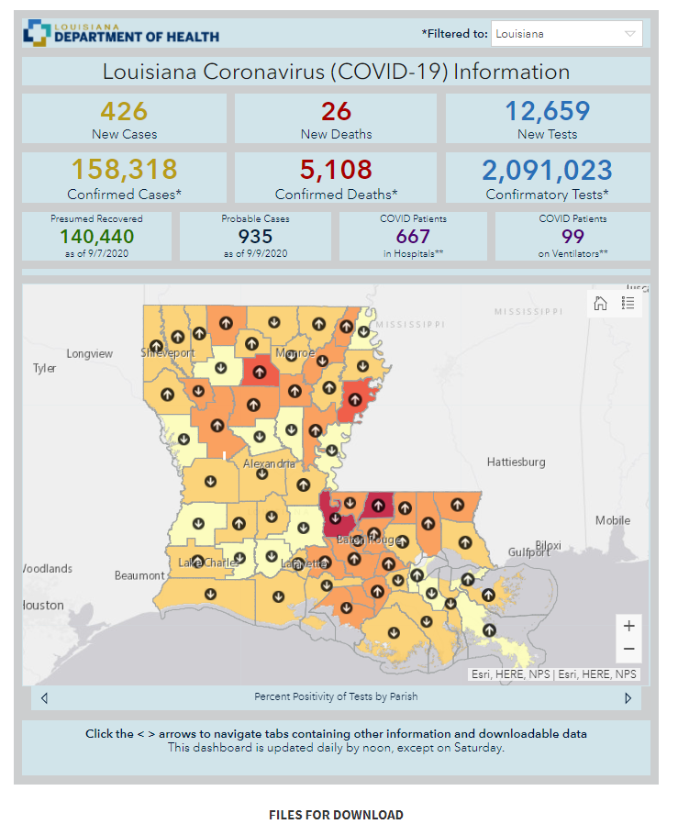
LDH’s Public Facing COVID-19 Dashboard
Additional COVID-19 information and resources
Downloadable historical data files
Notes:
Our state’s first COVID-19 case was recorded on March 9 and our COVID-19 dashboard went live on March 14. Since that time, our Bureau of Health Informatics team has updated the dashboard every day at noon, and have consistently added functionality, data, and visualizations that help the public, local officials and health care providers understand what’s happening statewide and what’s in their specific area of the state.
Our dashboard has received more than 35 million visits since going live. Because there was such a significant amount of traffic to the dashboard, we also feature important public facing information and resources prominently on the dashboard, including community based testing sites, information about COVID-19 outbreaks by location, guidance for long-term care facilities and our state’s testing plan.
In addition to daily updates on our dashboard, our governor also held daily press conference for the first months of the pandemic, often sharing data and modeling in real time to help the media and public understand not only the dynamics of the virus in our state, but also the information and data that he uses on a daily basis to make his decisions.

Slide 11
Defending our data
Encountered local officials who were skeptical of LDH’s COVID case data
Proactively held calls with those local officials, state legislators, hospital executives, physicians and regional medical directors to walk them through our data and build confidence
Worked closely with state’s legislative auditor to explain data cleaning and de-duplication processes
Notes:
Although we’ve been very forthcoming with data and information about COVID that we’re using to make decisions, not everyone appreciates or trusts data, especially from the government, in the same way. This, combined with politics, led to some challenges with data interpretation and local assessments of how COVID-19 was or was not affecting particular communities in the state.
These controversies related to data stemmed from a very common practice. Early on in the pandemic, we began sharing data about COVID+ cases with local emergency response officials, so that they could be aware of and protect themselves from potentially infectious individuals, especially given the limitations on available PPE during the initial months of the pandemic.

Slide 12
Widespread community-based testing
COVID-19 Testing by State (August 2020)
Source: Kaiser Family Foundation
Notes:
Widely available, community based testing has also been a major component of our COVID response effort. We’re very proud of the capacity we built in house in our state laboratory and at community-based testing sites. We partnered closely with the Louisiana National Guard and local providers to roll out community based testing sites that make tests available at no charge.
Since March, more than 1.6 million test results have been reported to us. At one point in April, we had the highest per capita testing rate in the nation. We continue to stretch the federal testing dollars to reach as many people as possible and were one of the 7 states that banded together in a purchasing collective along with the Rockefeller Foundation to engage in the partnership with the Rockefeller Foundation to secure 3.5 million rapid tests. (Status?)

Slide 13
Strategic Communications & Messaging
Key messages shared through credible and relatable messengers
Notes:
One of the primary strategies that we used to get critical messages out and drive up compliance with policy interventions like the requirement wear face coverings or the stay at home order, was to use trusted messengers in our community. Whether it was the local public health physician, LSU head coach Ed Orgeron, or popular Louisiana musicians, these trusted messengers could more effectively influence individuals to heed the public health guidance and orders than the governor or other state officials could.
We also worked closely with our faith leaders throughout the state to develop and distribute messaging, and encourage compliance with policy interventions and with our statewide contact tracing effort.

Slide 14
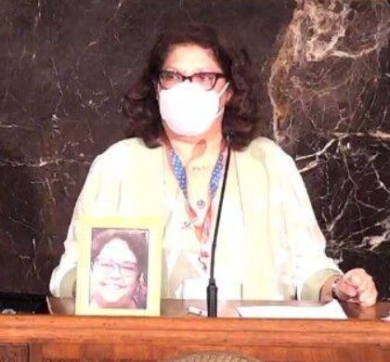
Strategic Communications & Messaging
Sharing personal, relatable stories about individuals affected by COVID-19
Notes:
Another messaging strategy that we found to be very effective was sharing personal stories. We know that data and graphs do not inspire everyone and it’s really the stories of COVID that make the risk real to people and spurs them to take the necessary actions to prevent spread.
Two examples of those personal stories that were highly impactful and gained a lot of traction in the press and on social media are pictured here – one is the story of on of our own Regional Medicaid Directors from a rural area, sharing the story of her cousin who she lost to COVID, prior to the face covering mandate being in place and how she had mask use been more widespread earlier on.
The other was a devastating story of a staff person in the Governor’s office who was lost to COVID at just 33 years old. This story really touched the hearts and minds of people across the state and getting these stories out there is a way to make the numbers more real to people, as I think we can become numb to the daily death tallies and statistics.

Slide 15
Medicaid Coverage & COVID-19
Louisiana expanded Medicaid in 2016 and has since cut the state’s uninsured rate in half
Expansion has helped to protect rural hospitals and strengthen state’s network of Federally Qualified Health Centers
Increased coverage and strong provider network have provided a strong foundation for COVID response
Notes:
Medicaid and Medicaid expansion have served as an important foundation to our state’s COVID response efforts. Approximately 1 in 3 individuals in our state have health coverage through Medicaid and I have no doubt that expanding Medicaid in 2016 put Louisiana in a stronger position to respond to the pandemic.
Since the Medicaid expansion, that state’s uninsured rate has been cut in half in our state in half, and racial, ethnic, and geographic disparities in both health coverage and access to care have narrowed. Many people who could gained coverage through expansion are adults at elevated risk from the virus, whether because they face a high risk of becoming infected or a high risk of serious illness if they contract COVID. Having an established source of health insurance and connections to providers prior to the pandemic helped to ensure quick access to care and testing. Further, those working-age Louisianans who have lost access to employer sponsored coverage as a result of business closures during the pandemic have Medicaid as a safety net to fall back on thanks to expansion.
Medicaid expansion also helped to strengthen our provider networks. As opposed to some of our neighboring states that have not expanded Medicaid, Louisiana has not had a single rural hospital close and our networks of rural health centers and federally qualified health centers have grown as a result. These community-based health centers have been close partners in both expansion of COVID-19 testing and treatment.

Slide 16
Medicaid Policy Changes
COVID Medicaid Policy Changes
Medicaid and CHIP Disaster SPAs
Section 1135 Waiver Approvals
Managed Care Contract Flexibilities
1915(k) Amendments (Appendix K)
Notes:
Because Louisiana has experienced more natural disasters than most states, our Medicaid staff is more familiar than most with the options and processes for requesting disaster based waivers and flexibilities. As a result, Louisiana was one of the first states to submit a request to and receive approval from CMS for 1135 waiver flexibilities, with our first request submitted on March 17. We also received approval on Medicaid and CHIP emergency state plan amendments and Appendix K amendments that allowed temporary changes to services provided to home and community based waiver recipients. Finally, we made temporary changes we made to our managed care organizations’ contract requirements that reduced face to face meeting requirements, site visits, and streamlined provider enrollment.
Our goal with all of these policy changes were to maximize access to services, minimize exposure risk, and reduce administrative barriers for both Medicaid members and providers.
For example one of our approved 1135 waivers for home and community based services allows Medicaid to pay family members and legally responsible adults to provide personal care services, as long as the person is capable of safely providing the services, which reduces risk of exposure to the patient from having an unrelated caregiver come into the home. We also greatly expanded the types of services that can be delivered via telehealth and suspended our requirement that telehealth be provided synchronously through both audio and visual channels, when both are not available.
While we expect these policies to be in place throughout the end of the public health emergency

Slide 17
Medicaid Policy Changes
Benefits & Services Changes
Extended authorization requirements
Pharmacy, DME, Home Health, Hospice, Therapies, PDHC
Relaxed hospital-based utilization management for medical stays
Pharmacy early refills and up to 90-day supply
90-day quantity for Durable Medical Equipment
Adding payable codes to the fee schedule
New lab codes for COVID-19 testing
Treatment in place for ambulance providers
Removed member/physician signature requirements
Relaxed NEMT driver participation requirements
Notes:
(Walk through list of Benefits and Service Changes)
We’re currently in the process of researching and investigating which of these flexibilities we may want to make permanent through a change to our Medicaid state plan or through other long-term policy changes.

Slide 18
Medicaid Policy Changes
Medicaid Eligibility
Accept self-attestation for all eligibility criteria, excluding verification of citizenship and immigration status, and conduct post-enrollment verification (planned to end October 2020).
Temporarily pause quarterly wage checks for Medicaid enrollees
Extend application and renewal processing timeframes Temporarily delay acting on certain changes in circumstances affecting Medicaid eligibility through end of PHE
Reinstate eligibility for all Medicaid beneficiaries whose benefits would have terminated on or after March 18, 2020, except those individuals that requested a voluntary termination of eligibility or ceased to be a resident of the State.
Notes:
(Walk through list of Medicaid eligibility policy changes – not comprehensive, but hits the high points)
Many of the Medicaid policy changes we applied and received approval for were related to eligibility, and many of these changes were required of state Medicaid programs in order to receive the enhanced 6.2% federal Medicaid matching rate that was included in the CARES Act.
After they were approved, many of these Medicaid policy changes needed to be coded into our Medicaid eligibility and payment IT systems. Most notably, we suspended many of the eligibility checks and renewal processes that our modernized eligibility system is programmed to conduct. It’s important to note that when the public health emergency ends, it will take states like ours some time to these eligibility system checks back on again, due to programming and testing requirements, and for eligibility staff to work through the backlog in annual renewals and verifications.

Slide 19
Medicaid Policy Changes
Telehealth
Overall goal was rapid expansion to ensure continuity of care
Previously exercised wide flexibility in covering telemedicine/telehealth, but this was not going to be sufficient
Policy Changes
Expanded origination site: patient can be at home or any other location
Expanded distant site: provider can be outside of a healthcare facility if needed
Expanded modalities: audio-only now allowed if a/v not available
Expanded services: physical therapy, occupational therapy, speech language therapy, applied behavioral analysis, pediatric preventive health visits
Notes:
(Go through list of telehealth changes)
We’re now in the process of examining which of these telehealth policy change that we’d like to extend beyond the public health emergency. We’re in discussions with provider organizations, Medicaid members and other stakeholders to determine which of these telehealth policy changes make sense to continue long term. We know that they have created conveniences for patients and providers that reduce barriers to care, but we also want to ensure that services provided via telehealth don’t have an impact on the quality or the effectiveness of the services a patient receives. We also have to examine carefully the potential for fraudulent activity among bad actors in the expanded telehealth landscape.

Slide 20
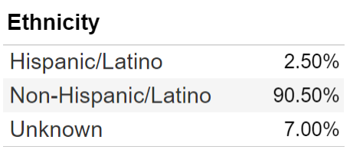
COVID-19 Louisiana Health Equity Task Force
COVID-19 Deaths in Louisiana by Race and Ethnicity (8/17/20)
On April 29, Gov. John Bel Edwards announced the creation of the COVID-19 Louisiana Health Equity Task Force
At that time, LDH data indicated that 70% of COVID-19 deaths were among African Americans, despite being 33% of the population
Charge: To provide recommendations relative to health inequities which are affecting communities that are most impacted by the coronavirus.
Notes:
Like many states, Louisiana’s COVID data indicated early on that minority communities in the state were disproportionately impacted by the virus. On April 29, our department released COVID death data broken down by race for the first time, which revealed that 70% of all deaths recorded at that time were among African Americans, despite being 33% of our state’s population. Since that time, that percentage has come down, but African Americans and other racial/ethnic minorities are still dying from COVID-19 at a disproportionate rate.
Gov. Edwards took swift action, after that initial data release, and created a COVID-19 Louisiana Health Equity Task Force comprised of health care industry leaders, legislators, academic partners, clinicians, health equity experts, and community based organizations to develop a plan of action to address the glaring disparities.
The task force charge was to provide reliable and data driven information on COVID-19 safety and prevention; Provide the medical community with best practices and protocols for treating communities with underlying medical conditions and health disparities; and ensure testing availability and ease of access for all communities.

Slide 21
Health Equity Task Force Major Recs
Reporting protocols for COVID testing sites on race/ethnicity
Independent Public Health monitor for state prisons/jails
Mandate provision of PPE by employers for frontline workers
Provide funding for retraining unskilled workers
Assist minority small business owners to restart or relocate their businesses
Create a Louisiana Health Equity Dashboard
Notes:
The Health Equity Task Force divided itself into 7 subcommittees and met frequently over the course of several months. The subcommittees issued a set of reports and recommendations that related to their charge.
Some of the most notable recommendations include:
-Establishing standardized COVID testing reporting protocols to ensure that information is consistently collected across multiple testing sites, especially those pertaining to racial and ethnic identity.
-The Governor should appoint a Statewide Independent Public Health Monitor over all jails and prisons
-Mandate the provision of personal protective equipment (PPE) by employers to frontline workers, as Illinois and California legislatures have done.
-Allocate for retraining unskilled workers who cannot return to their old jobs.
-Assist micro and small minority business owners restructure and restart, start or relocate their businesses in those impacted communities.
-Create a Louisiana Health Equity Dashboard
Many of these recommendations are still being fleshed out and are in the research and development phase. The Louisiana Health Equity Dashboard will likely be developed by and housed within our Department’s Office of Community Partnerships and Health Equity. The plan is that it will track a variety of social, economic, and environmental indicators during and after the COVID-19 pandemic to ensure that the disparities highlighted by COVID continue to be measured, monitored and addressed long after a vaccine becomes available and herd immunity is achieved.

Slide 22
Policy Needs and Outstanding Requests
Longer term, automatic and more robust increases in Medicaid FMAP (12% as with ARRA)
Guidance and flexibility from CMS following Public Health Emergency to “unwind” Medicaid eligibility policy changes and work through backlog
Additional federal disaster relief legislation
Additional funding for contact tracing and testing
State and local revenue stabilization funding
Enhanced Unemployment Insurance payments
Additional business relief
Notes:
Some of the early policy interventions, flexibilities and supports that Congress and the federal government put in place during early days of the pandemic. Some of those interventions have expired or will soon expire, such as the 6.2% increase in the Medicaid federal match, which is set to expire at the end of the year. The National Governor’s Association has requested that that enhanced rate be increased to 12% and extended through the end of federal fiscal year 2021 for all states. After that, the NGA has requested that the enhanced rate be left in place until the national unemployment rate drops below 5%.
We are also awaiting guidance from CMS about how to phase application and renewal reviews back in when the public health emergency ends. Because we’ve “turned off” so many of our eligibility reviews functions, we know the our Medicaid team will face a large backlog of applications and renewals to work through, in addition to re-programming the eligibility system to resume the standard eligibility procedures. We’ve requested from CMS a 6 month extension of eligibility decision timelines after the PHE ends, to ensure that we an work through that backlog.
As with all states, we expect our COVID-19 response effort to be ongoing for the foreseeable future. We know that we will need federal assistance to continue to level of testing and contact tracing that is essential to preventing the spread of COVID-19. Additional federal legislation is needed to ensure state and local governments can address revenue shortfalls and continue to provide basic services and resources to the public and that individuals who lose their jobs are able to maintain stable housing and meet their basic needs while the economy recovers, businesses reopen, and the job market strengthens.

