Slide 2
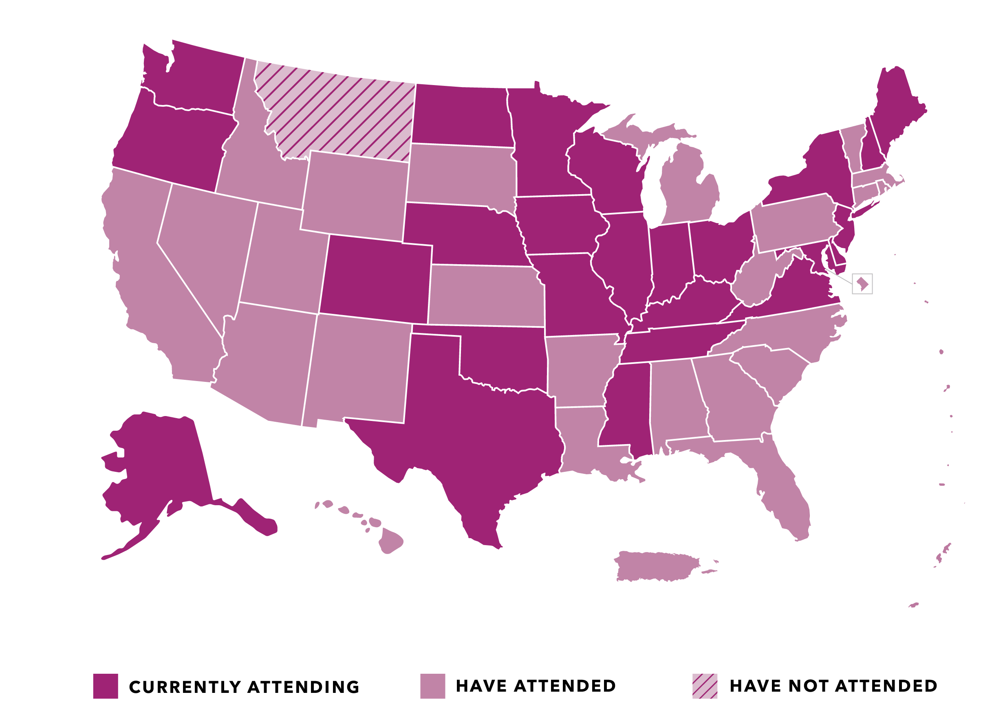
States Represented at Medicaid Policy Academies

Slide 3
Facilitating Leaders
Representative Ed Clere
Indiana
Representative Susan Lontine
Colorado

Slide 6
Accessing Care during a Pandemic
Andrea Bennett, PhD
Senior Director, Public Policy
September 23, 2020
Notes:
Good afternoon everyone. It’s great to be with you and you’ve already heard from great speakers about how COVID has impacted Medicaid. I want to take us into the realm of the Medicaid member. At CVSH/Aetna, we work hard to be “member obsessed” meaning that everything we do has the member in mind. We saw firsthand how access to care changed during COVID, and we know that some of those changes are likely here to stay. I want to walk us through the experiences of three different families with Medicaid coverage and what implications that has on future access to care.

Slide 7
Pregnant mom at risk of preeclampsia
1
2
Pre-COVID
Supporting provider care plans, members received educational materials and phone calls from managed care case managers to encourage new mothers to engage in prenatal care visits
During pandemic
Blood pressure cuffs delivered to high-risk pregnant members free of charge
Members received letters and phone calls about telehealth and other prenatal care services available at no cost-sharing during the public health emergency
6
©2020 CVS Health and/or one of its affiliates. Confidential and proprietary.
Notes:
I’d like to start with a woman who is pregnant and has been identified by her doctor as being “high-risk” of preeclampsia. Before COVID, we would communicate with high risk pregnant members and encourage them to attend the prenatal care visits that their doctors had recommended due to the members’ risks.
CLICK
During the pandemic, we continued to encourage prenatal care visits, but we also worked with providers on certain types of services that might be conducted via telemedicine and made sure members knew about these options.
CLICK
Also, high risk pregnant moms on our plan received blood pressure cuffs in the mail so they could regularly check their blood pressure at home and report the information to their doctors. This helped limit the physical trips they had to make for monitoring.
NEXT SLIDE

Slide 8
Pregnant mom at risk of preeclampsia
1
2
Pre-COVID
Care coordinators helped schedule prenatal care appointments for high risk members and assist with transportation if needed
Post care all delivered in-person
Post pandemic
Plans gifted a crib to women for completing prenatal services in-person and via telemedicine and held a “virtual baby shower” in lieu of an in-person shower
Some post care handled via telemedicine (e.g., counseling for post-partum depression)
Moving forward, what prenatal and postnatal care can be provided via telemedicine by primary care providers and what needs to be in person?
During pandemic
Care coordinators helped connect women to virtual prenatal care for some services and made sure they had the needed technology for telemedicine. They also helped women schedule in-person prenatal care with their providers when necessary
7
©2020 CVS Health and/or one of its affiliates. Confidential and proprietary.
Notes:
Before COVID, our care coordinators often worked with pregnant women to schedule their prenatal care visits and post care visits, which were essentially all done in person. If a women needed transportation, we would help schedule that for them.
CLICK
During the pandemic, most of our members still scheduled in-person visits but we also helped several pregnant moms schedule telemedicine visits, if appropriate, made sure pregnant women had the technology to access care via telemedicine.
CLICK
In several of our health plans, we would hold baby showers for moms that completed prenatal care visits and gift them a crib. We made sure women still had this incentive during COVID but held virtual baby showers instead. They were actually a lot of fun. Another change during COVID is how postcare has been handled. Although some post care needs to be in person to ensure women are recovering, some women received post care for common conditions such as postpartum depression via telemedicine.
CLICK
So, looking ahead, we are continuing to explore how we can ensure women get the in person pre and postnatal care they need, while supplementing with some telemedicine services that can limit trips when clinically appropriate.
NEXT SLIDE

Slide 9
Adult with hypertension
Pre-COVID
Members often visited their primary care providers in-person and received prescription for blood pressure medicine
Members often physically went (walk, drive, public transit) to pharmacies and picked up a 30-day supply of blood pressure medication
Members received a 90-day supply of blood pressure medicine delivered to their homes free of charge
Post pandemic
How can we ensure easy and consistent access to maintenance medications long-term?
During pandemic
Plans helped facilitate access to telemedicine visits with their primary care providers to ensure timely refills of medications
8
©2020 CVS Health and/or one of its affiliates. Confidential and proprietary.
Notes:
Let’s turn now to an adult who has hypertension. High blood pressure is a common chronic condition and prior to COVID, an adult would typically get a prescription from a doctor for blood pressure medicine who needed it. Then they would physically go to the pharmacy to pick up a 30 day supply of medication. A few states allowed for a 90 day supply of maintenance meds prior to the pandemic but not all states.
CLICK
When COVID hit, some of our members weren’t able to get refills over the phone, so we helped facilitate telemedicine visits with the member’s primary care provider to get that refill.
CLICK
But the other major change was that due our partnership with states on flexibilities during COVID, members were able to receive a 90 day supply of maintenance medications such as blood pressure medicine and free home delivery.
CLICK
Moving forward, we know that some medications need certain quantity limits and other safegaurds, but we are interested in some of these flexibilities remaining long-term to help members have consistent and easy access to their medications.

Slide 10
Child who needs a wellness exam
1
2
Pre-COVID
Plans sent written communication to parents reminding them of the need for a well-child exam and vaccinations with pediatricians
Text messages as part of CVSH TimeForCare campaign to remind parents of need for vaccinations/well-child exams
During pandemic
Care manager called and sent letters to parents reminding them of the need for a well-child exam and vaccinations with pediatricians
9
©2020 CVS Health and/or one of its affiliates. Confidential and proprietary.
Notes:
And finally, as you all know, children make up a large share of the population covered by Medicaid. And well child exams, including vaccine administration, are really important no only for the child but from a public health perspective. Prior to COVID, our members would receive reminders from us and their providers about well-child exams.
CLICK
But when many elective procedures stopped back in March, many parents did not take their children in for these visits, even with the individual outreach we engaged in with members.
CLICK
This is an area of concern and as part of the CVSH TimeForCare campaign, we are about to launch a text message campaign further encouraging parents to take their child in for well child exams.

Slide 11
Child who needs a wellness exam
1
2
Pre-COVID
Parents took their children into physician’s office for well-child exams and vaccinations.
Care managers helped facilitate needed treatment services from well-child exams such as speech therapy that are conducted in person
Care managers helped facilitate needed treatment services identified through well-child exams such as speech therapy that are conducted via telemedicine.
Post pandemic
Are there alternative ways to ensure children receive needed vaccines and treatment for diagnoses?
During pandemic
Parents still took their children into physician’s office for well-child exams and vaccinations.
10
©2020 CVS Health and/or one of its affiliates. Confidential and proprietary.
Notes:
Another piece of this is how care is delivered. Much of well child exams have to be done in person because the provider is physically examining the child and administering vaccines.
CLICK
This hasn’t really changed during COVID.
CLICK
But, some of our members have been able to access needed treatment such as speech therapy through telemedicine during COVID. And this is something we think might be possible for some services longer term.
CLICK
Post-pandemic, we are exploring not only how treatments might occur virtually if needed, but also if there are additional avenues to ensure that children don’t miss timely vaccines. We know that vaccines help protect the child but also the community from public health diseases and outbreaks so this is a top priority for us.
NEXT SLIDE

Slide 12
Looking Ahead: State Medicaid Policy
Telemedicine likely to remain long-term
Access to clinically appropriate care
Safeguards for fraud & abuse
Support for provider & member capacity
Past recessions reveal what to expect
Provider, MCO,& benefit/program cuts, especially without additional relief from Congress
Moving populations into managed care
COVID-19 testing and vaccine will continue to be central issues
Immunization coverage for adults in traditional populations
Coverage for rapid tests
Notes:
Now that I walked through three journeys of how access to care change, in closing, I want to highlight three expectations we have for state Medicaid policy in the coming months.
First, relates to telemedicine. We believe some of the flexibilities that have been allowed during COVID will continue long-term. But we also want to stress the need for telemedicine to have safeguards to ensure clinically appropriate care and make sure providers and beneficiaries have the capacity to engage in telemedicine.
Second, we know, based on previous recessions that cuts to Medicaid programs may be coming as states look for specific ways to keep their budgets in check. In considering cuts, it’s important to remember the impact cuts have on providers, members, and health plans ability to care for members.
And finally, coverage for covid testing and a pending vaccine will continue to be considered at the state and federal levels. We anticipate a significant budget impact for vaccine administration and some coverage inconsistencies for immunizations in Medicaid may cause issues in some states.

