Slide 1
Hepatitis C in Pregnancy – the other “C” virus – rising rates, slow solutions
Tatyana Kushner, MD, MSCE
Assistant Professor
Division of Liver Diseases
Icahn School of Medicine at Mount Sinai

Slide 2
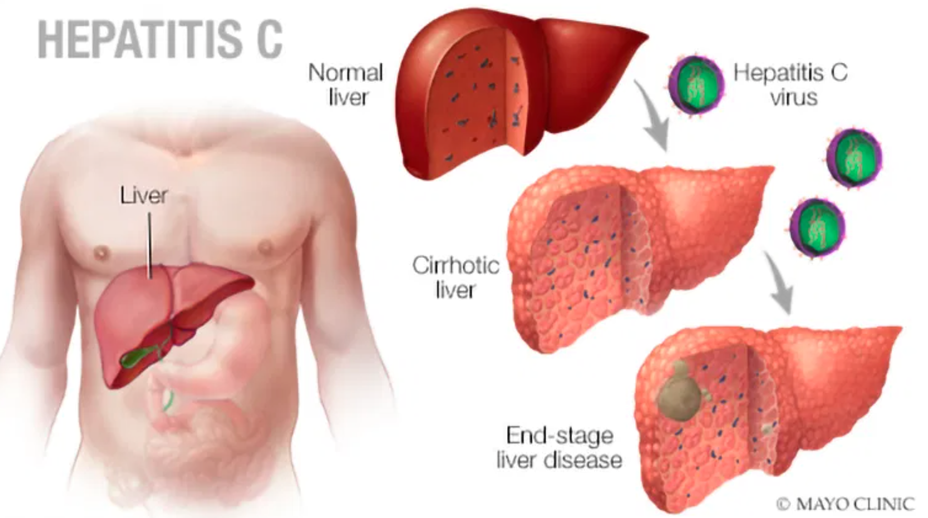
Hepatitis C Virus (HCV)
Most common bloodborne virus in the US – 2.4 million lives affected
HCV is TREATABLE & CURABLE
BUT state restrictions still placed on obtaining HCV therapy
Hepatitis C is transmissible, including during pregnancy
WHO – eliminate HCV in 2030 as a public health threat
Young adults have the highest rates of acute HCV infections, and rates in this group are increasing at a higher rate than other age groups
This includes pregnant women..AND their infants

Slide 3
Pregnancy: an opportunity to optimize overall health outcomes for women and child
Pregnancy is usually the first touchpoint of women with the health care system
Pregnancy may be the ONLY time that a woman has Medicaid coverage
You can diagnose, CURE, and prevent transmission of Hepatitis C to babies all during pregnancy
Universal Screening is still not endorsed by American College of Obstetrics and Gynecology
Universal screening is not performed “universally”
1000’s of women go through pregnancy undiagnosed
Children of women with HCV are usually NOT tested appropriately
Women who screen positive are lost to follow up post delivery – DESPITE AVAILABLE CURATIVE THERAPY
BUT

Slide 4
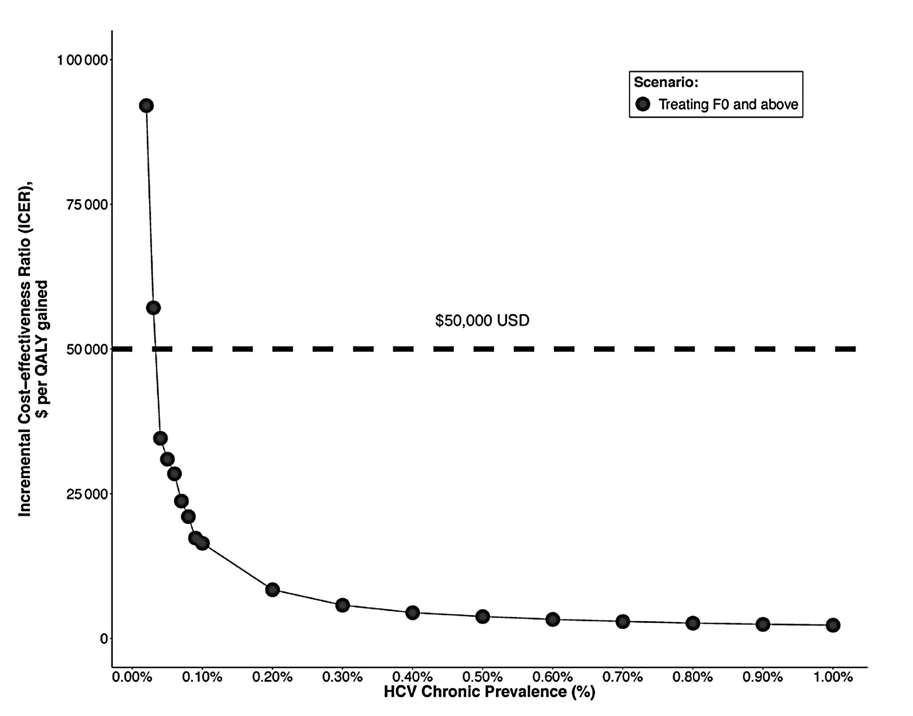
Are these measures Cost-Effective?
Cost-effectiveness analysis comparing universal and risk-based screening
Universal screening of ~5 million pregnant women in 2018 could result in detection and treatment of an additional 33,000 women and 300 children
Cost-effective even in low prevalence areas and across all fibrosis stages
Kushner, CSG, 2020

Slide 5
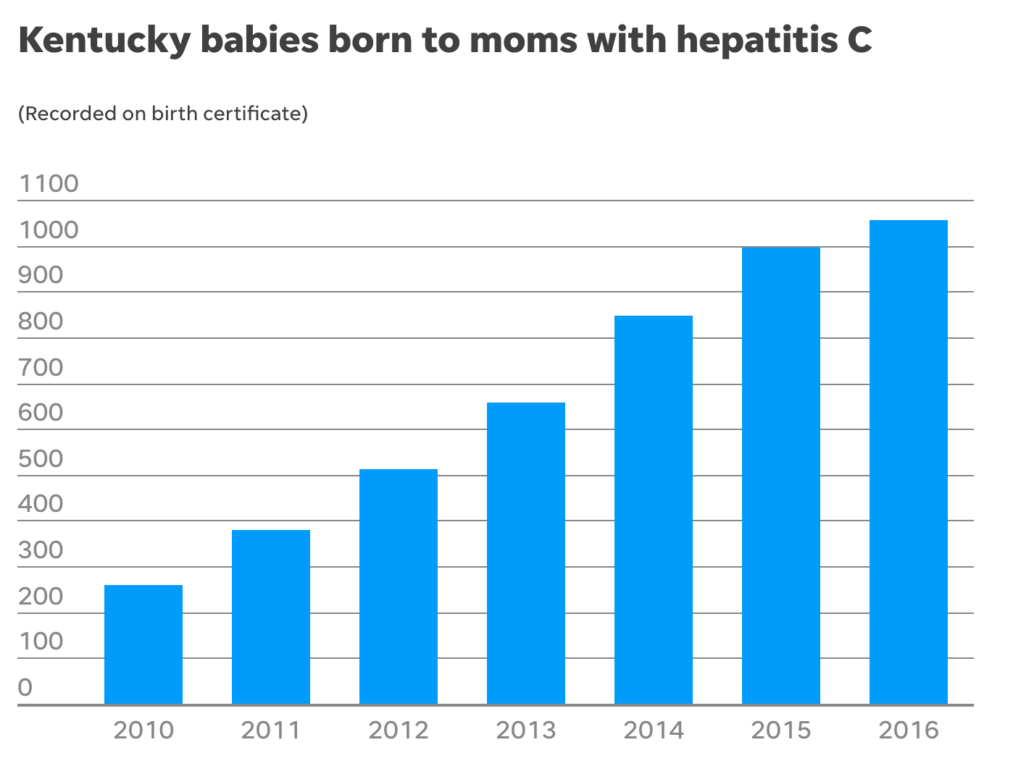
Can legislators help?
Kentucky
1 in 56 babies born in Kentucky from 2014-2016 were to moms with a history of hepatitis C
Births quadrupled between 2010 and 2016
Funding is needed to improve screening rates, support initiatives to expand screen (especially in rural settings, and improve access to treatment)
Kushner, CSG, 2020

Slide 6
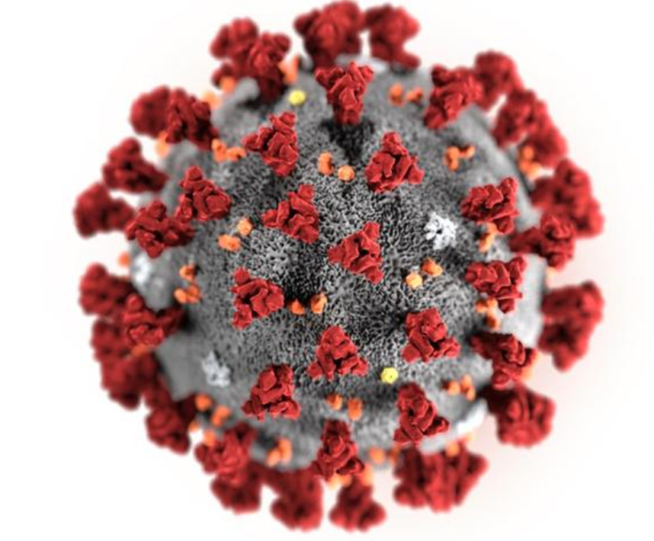
How has COVID-19 impacted care
HCV elimination programs have been placed on hold
Already seeing increase in opioid related overdose deaths
Anticipated increased risk of HCV transmission
COVID-19 is an opportunity to bring our focus back on Public Health!
Kushner, CSG, 2020

Slide 7
Conclusions
Pregnancy is an opportunity
HCV is easy to diagnose
HCV is easy to cure
HCV is associated with very costly long term disease outcomes if not addressed
Cirrhosis, Liver Cancer, need for liver transplant
STIGMA for mothers and their children
Governmental support would go a long way to improve diagnosis, linkage to care, and cure of women with HCV – and it can start in pregnancy

