Slide 1
Planning for 2021 in the Midst of Historic Uncertainty: Implications for States + Medicaid
Rachel Nuzum
Vice President, Federal and State Health Policy
Council of State Governments, Medicaid Policy Academy
September 25, 2020

Slide 2
States Facing Unprecedented Uncertainty in 2020

Slide 3
COVID-19 Related Revenue Loss By Payer
Manatt Analysis of Provider Relief Funds and Impact on Medicaid Providers. September, 2020

Slide 4
Overall State Health System Performance, 2020 Scorecard
Medicaid Expansion Status
Not yet expanded Medicaid (12 states)
Quartile 1 – Top Performing States (12)
Traditionally expanded Medicaid (28 states + DC)
Quartile 2 (13 + D.C.)
Expanded Medicaid with 1115 waiver (7 states)
Quartile 3 (12)
Ballot initiative to expand Medicaid passed, state has not yet expanded (3 states)
Quartile 4 – Bottom Performing States (13)
Radley, David C., Sara R. Collins, and Jesse C. Baumgartner. “2020 Scorecard on State Health System Performance.” The Commonwealth Fund. September 11, 2020. https://www.commonwealthfund.org/publications/fund-reports/2020/sep/2020-scorecard-state-health-system-performance

Slide 5
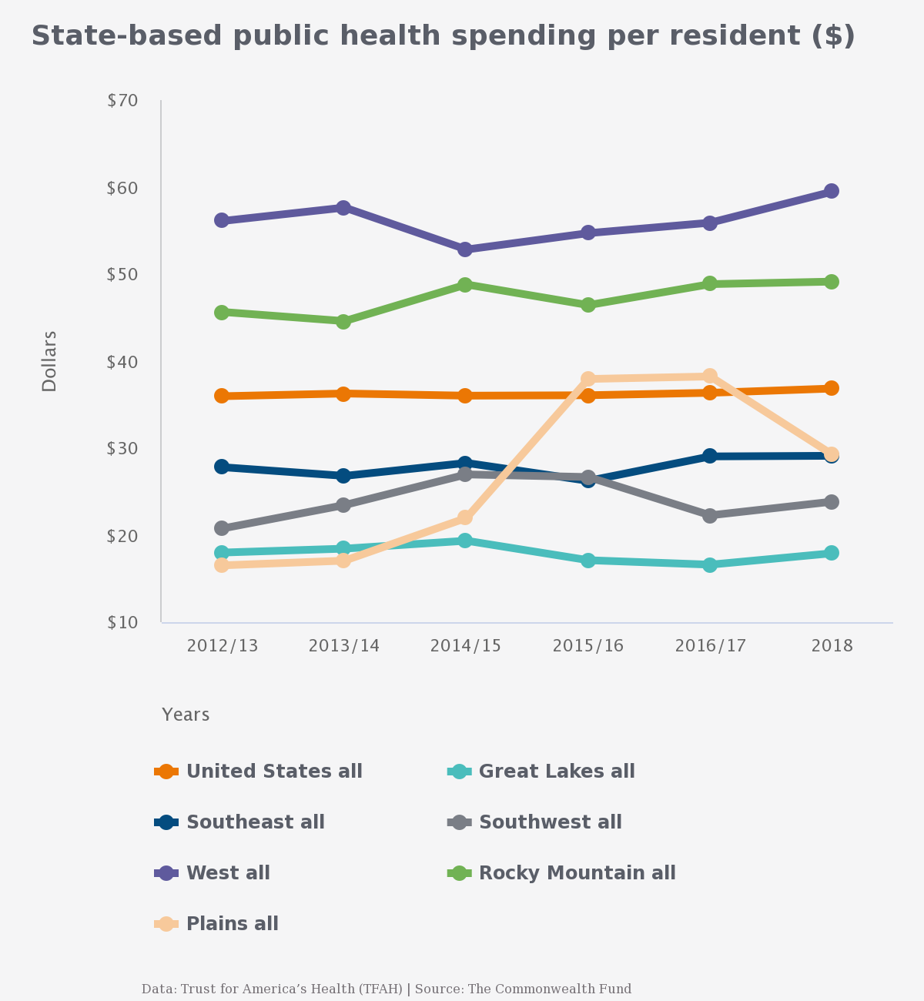
State-based public health spending per resident ($)
Radley, David C., Sara R. Collins, and Jesse C. Baumgartner. “2020 Scorecard on State Health System Performance.” The Commonwealth Fund. September 11, 2020. https://www.commonwealthfund.org/publications/fund-reports/2020/sep/2020-scorecard-state-health-system-performance

Slide 6
Effects of Medicaid Expansion on Total, Federal, and State Medicaid Spending, State Fiscal Years 2015–2019
Ward, Bryce. “The Impact of Medicaid Expansion on States’ Budgets.” The Commonwealth Fund. May 5, 2020. https://www.commonwealthfund.org/publications/issue-briefs/2020/may/impact-medicaid-expansion-states-budgets

Slide 7
Thank You!
For more information please visit: commonwealthfund.org and follow us @commonwealthfnd
Contact Information:
Rachel Nuzum, Vice President, Federal and State Health Policy
rn@cmwf.org @raenuzum

