Slide 4
CSG Medicaid Policy Academy
September 25, 2020
An Update on State Fiscal Conditions

Slide 5
State General Fund Spending Was Expected to See Modest Increase in Fiscal 2021 Before COVID-19 Crisis
*Average
* 42-year historical average annual nominal growth rate in state general fund spending is 5.4 percent.

Slide 6
Most States Continued to Strengthen Rainy Day Funds Coming Into the COVID-19 Crisis Median balance reached all-time high in Fiscal 2019 and was on track to beat that record in Fiscal 2020 before COVID-19 crisis
Source: Spring 2020 Fiscal Survey of States

Slide 7
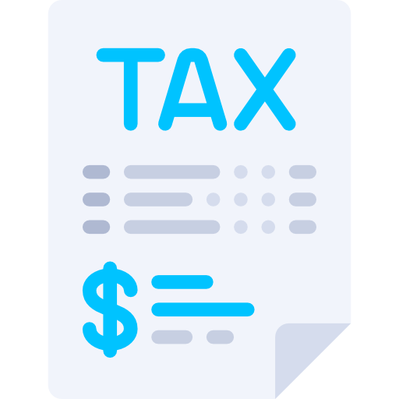
Revenue declines during Great Recession (From fiscal 2008 to fiscal 2010)
-11.6%
-6.8%
-14.7%
Total general fund revenue
Sales Tax
Personal Income Tax
-24.1%
-7.8%
-8.2%
Corporate Income Tax
Gaming Tax
All Other Revenue

Slide 8
Note: Some states reported estimates for fiscal 2020, as preliminary actual data were not yet available.
* The figures reported above only include states that operate on a July to June fiscal year, as these states all experienced a similar period of COVID-19 impact on their fiscal 2020 revenues. The states that do not operate on this cycle include New York (fiscal year starts on April 1), Texas (September 1), Alabama and Michigan (October 1), and New Jersey (only for fiscal 2021, October 1).

Slide 9
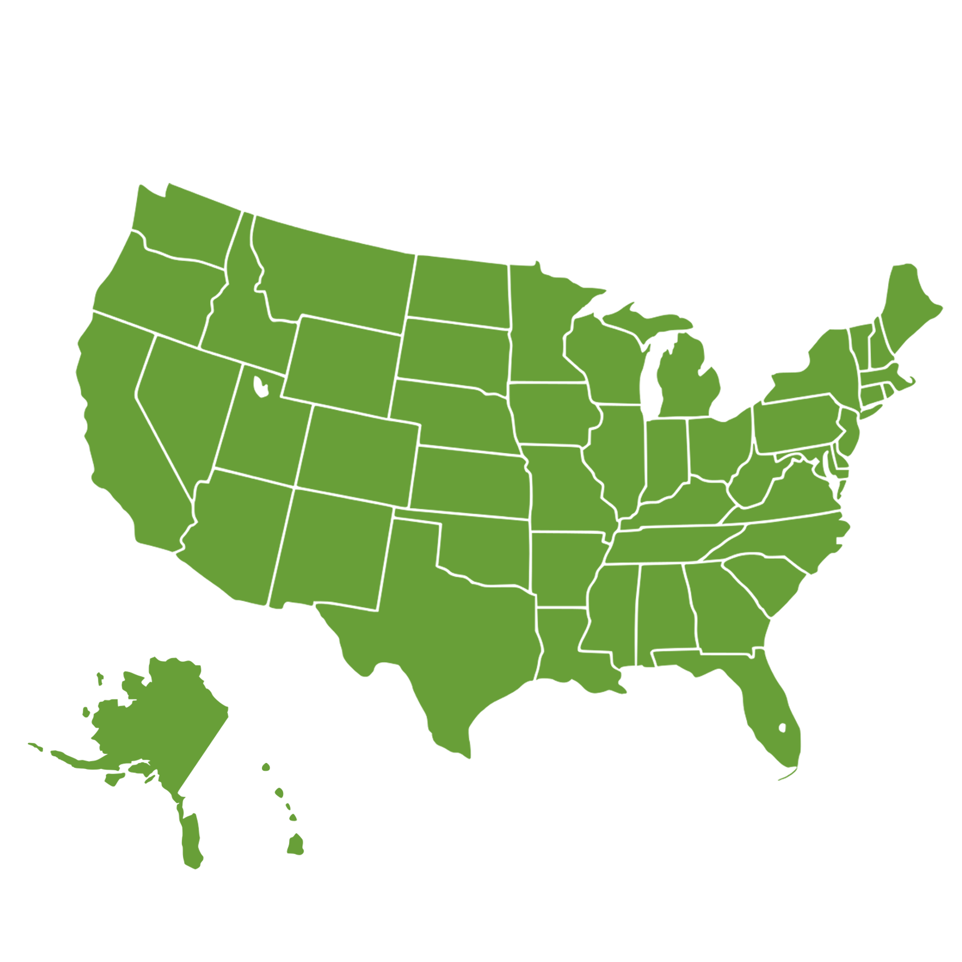
All sources of revenue (personal income, sales, corporate income, motor fuel, gaming) are being impacted by COVID-19
Impacting states in different ways and different magnitudes - e.g. oil producing states; tourism; manufacturing
States are revising revenue forecasts
Different than other recessions – public health emergency and sharp economic declines
States are facing both increased spending demands and less revenue than expected
What is the current fiscal environment for states?
(SEPTEMBER 2020)
9

Slide 10
Total State Expenditures
By Function
Estimated Fiscal 2019
Source: NASBO State Expenditure Report

Slide 11
General Funds Expenditures
By Function
Estimated Fiscal 2019
Source: NASBO State Expenditure Report

Slide 12
States will continue to respond to increased spending demands from the coronavirus
Adjusting revenue forecasts for fiscal 2021
Question of how much federal aid and how flexible
States will likely face impact of COVID-19 for many years to come
Fiscal 2021 budgets will continue to be revised, including after enactment
Outlook for states FY 2021 and beyond
12

Slide 13
www.nasbo.org
Stacey Mazer
Senior Staff Associate
smazer@nasbo.org
National Association of State Budget Officers | NASBO

